Slide 1
Shopping Trends
Analysis
Business Insights Report
Foundations of Data Science — Capstone Project
Presented by
Team Nebula
Vansh Jain · Kapish Garg · Bhavya

Slide 2
The problem
Retailers have data.
Most have no idea what to do with it.
Who is actually buying?
What drives revenue?
Do discounts work?
Which customer segments exist, and what truly drives their purchase decisions?
Which product categories and items generate the most income — and is that position sustainable?
Are promos actually lifting basket size, or just giving away margin on purchases that would happen anyway?
Our goal: turn 3,901 transaction records into clear, actionable business intelligence.

Slide 3
Data wrangling
The data was a mess. Here's what we fixed.
3,901
01 — Missing values
59 rows dropped across 4 columns. Only 1.5% of the dataset — a clean cut with no meaningful data loss.
Transactions
59
02 — Gender labels
10 different spellings of Male and Female (e.g. 'FEMALE', 'F', ' female') mapped to two clean labels.
Rows Dropped
3
03 — Shipping types
24 chaotic variants collapsed into 6 clear, consistent options using regex and manual mapping.
New Features
0
04 — Payment methods
26 spellings unified into 6 types. 'Credit-Card', 'CreditCard', 'credit card' — all the same, now treated as one.
Nulls Left
3 new features engineered after cleaning: Age_Group · Spending_Tier · Used_Any_Discount

Slide 4
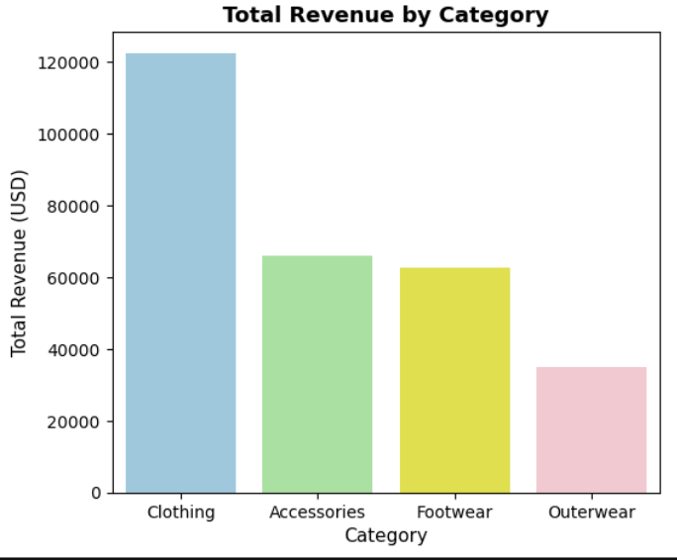
Revenue by category
Clothing isn't just
winning. It's in a
different league.
Clothing at $122K — nearly double Accessories and Footwear combined.
Accessories and Footwear neck and neck at ~$64K each.
Outerwear at $35K — less than 30% of Clothing revenue.
Clothing is the backbone of the business — generating nearly double the revenue of the next category.

Slide 5
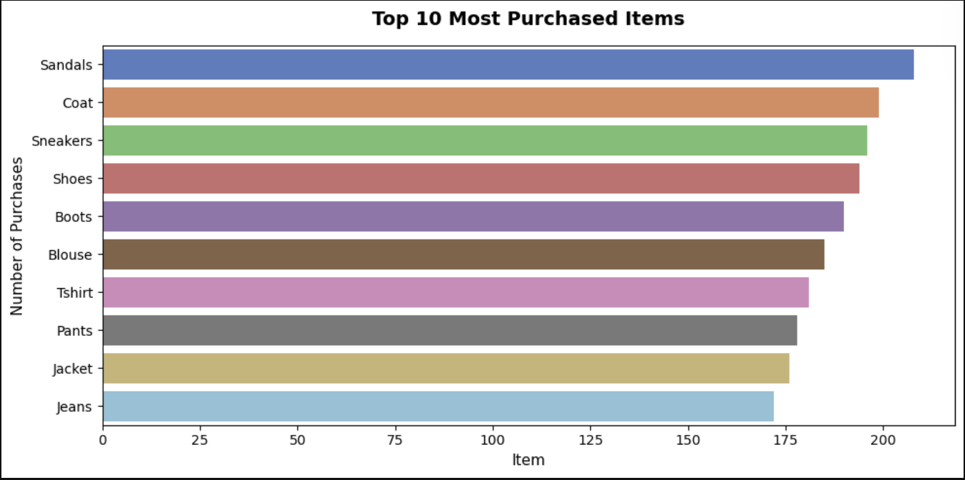
Top items
The real bestsellers cut across every category.
Only 34 units separate #1 from #10 — demand is remarkably flat. No single item dominates, so inventory risk spreads evenly. Footwear holds 3 of the top 5 spots; Clothing fills the rest.
Sandals leads at 208 units
The top item outsells the 10th by only 34 units. No concentration risk, but broad category coverage is critical.
Footwear + Clothing = top 10
All bestsellers come from just two categories — invest in both, not just the revenue leader.

Slide 6
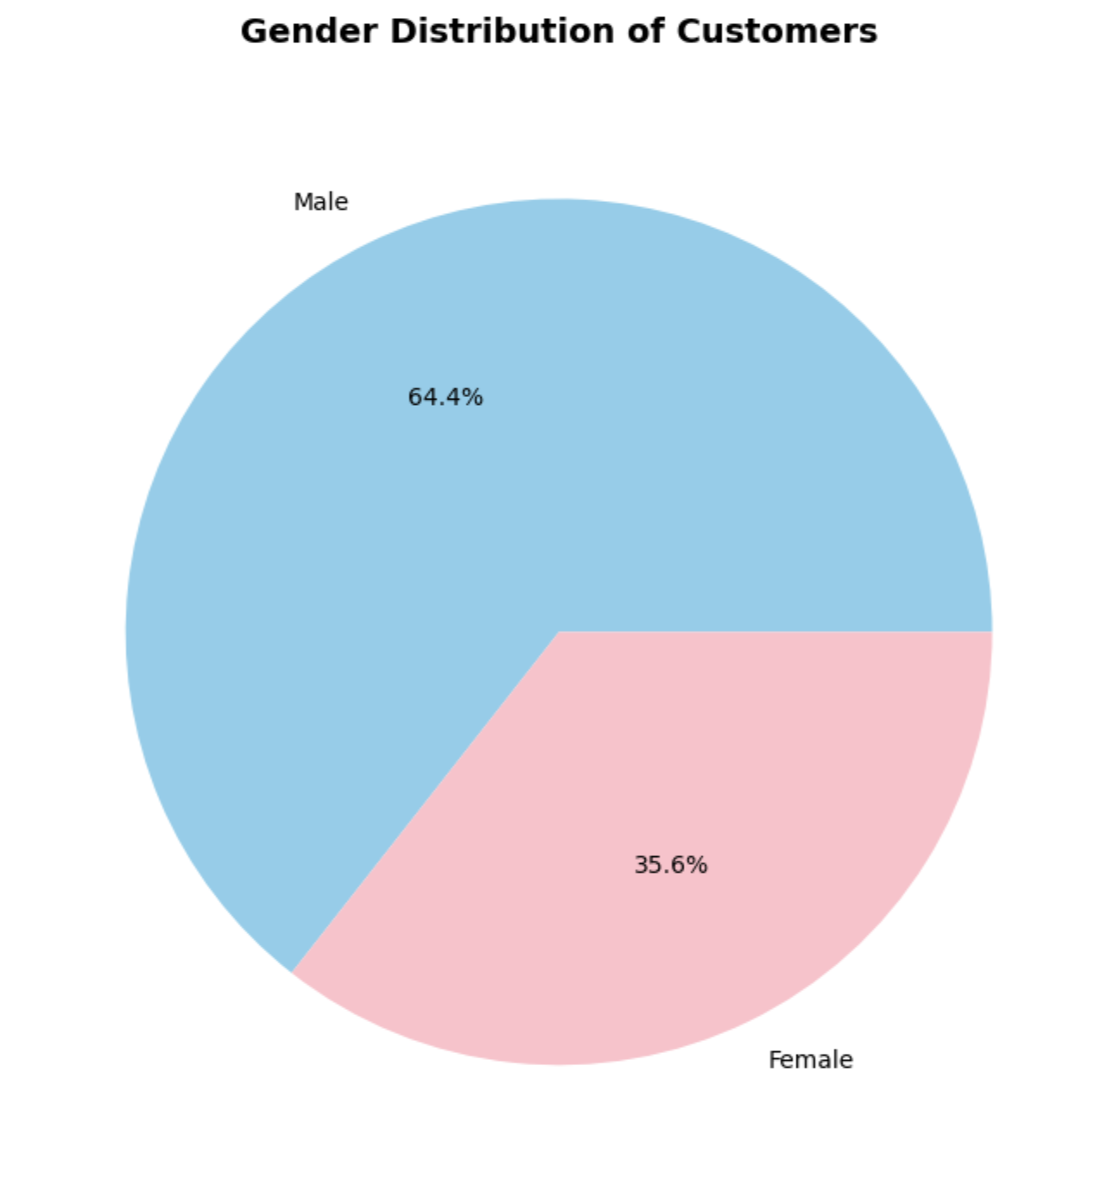
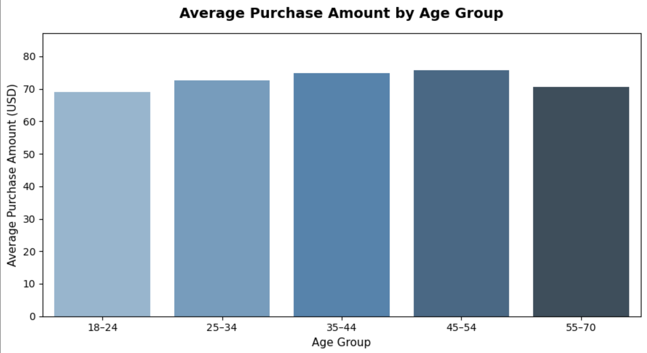
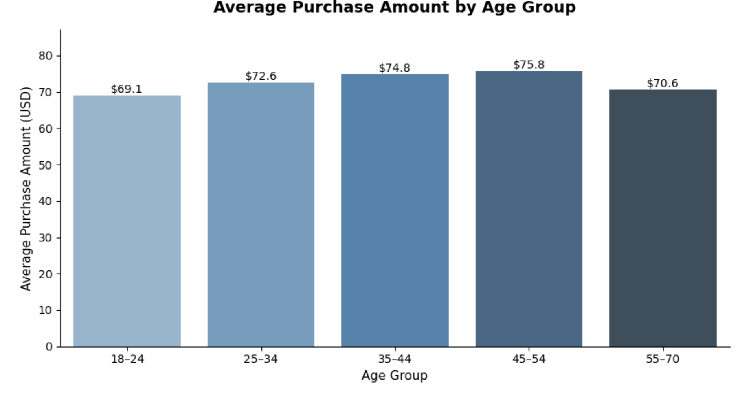
Demographics
Every demographic
spends almost exactly
the same.
Gender Split
Core finding: A 65-year-old and an 18-year-old contribute the same ~$73 per transaction. Age-based or gender-based targeting is unlikely to yield meaningful revenue differences.

Slide 7
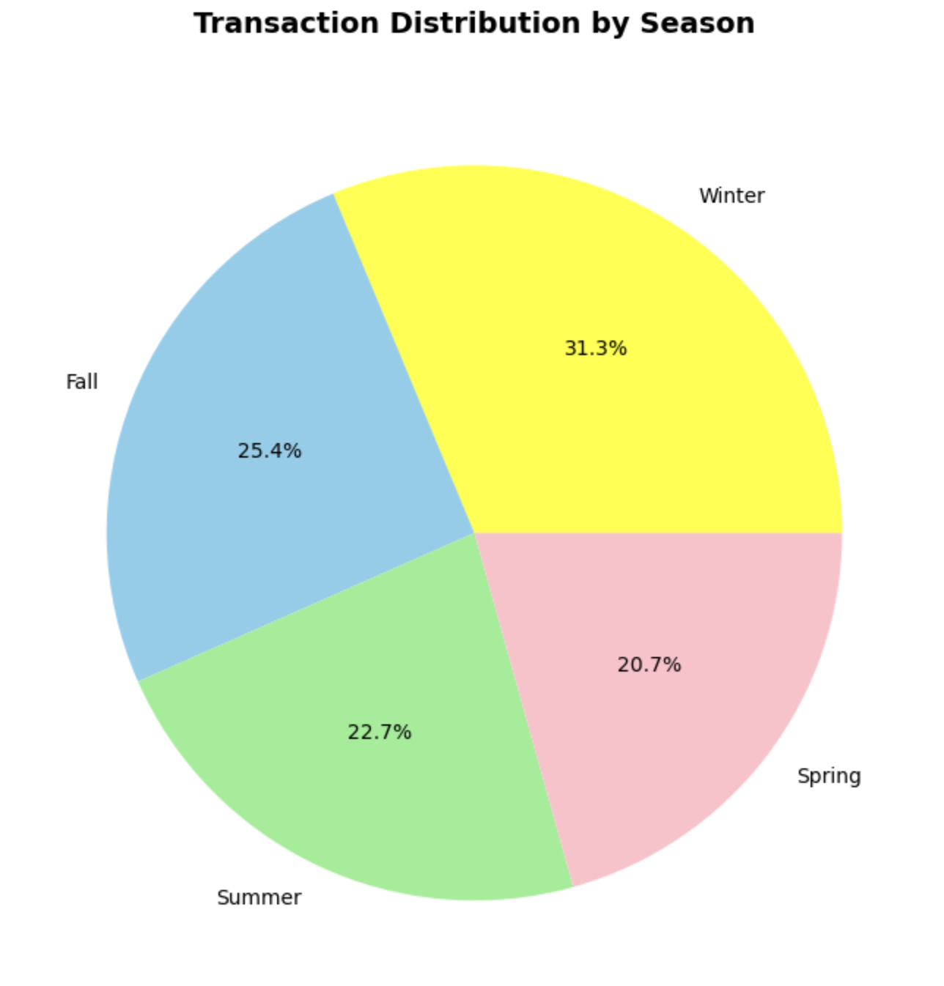
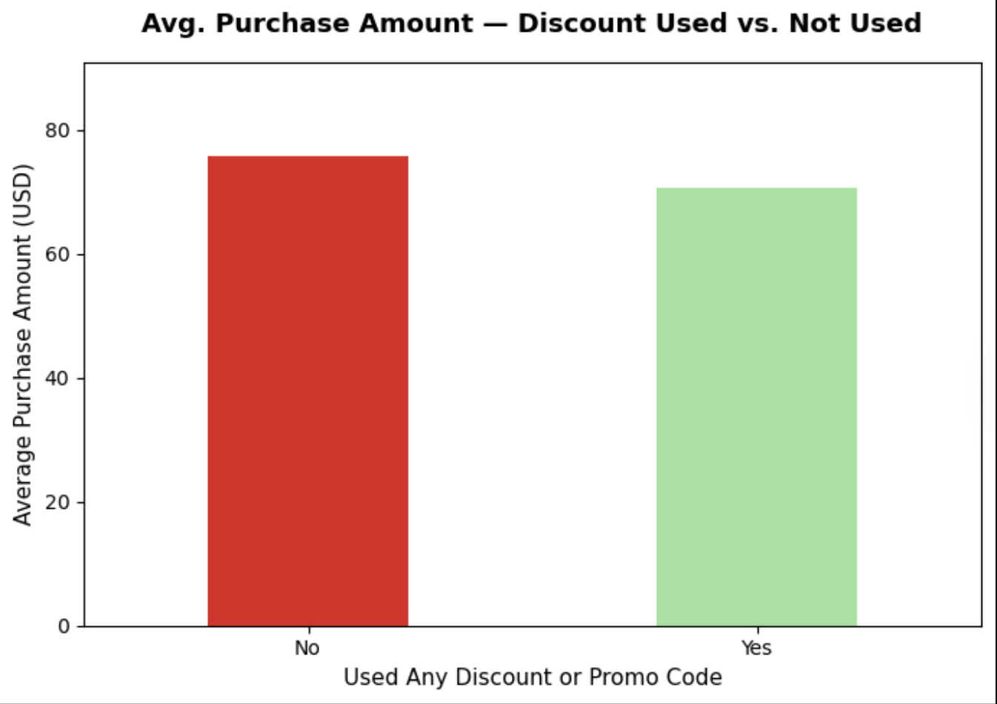
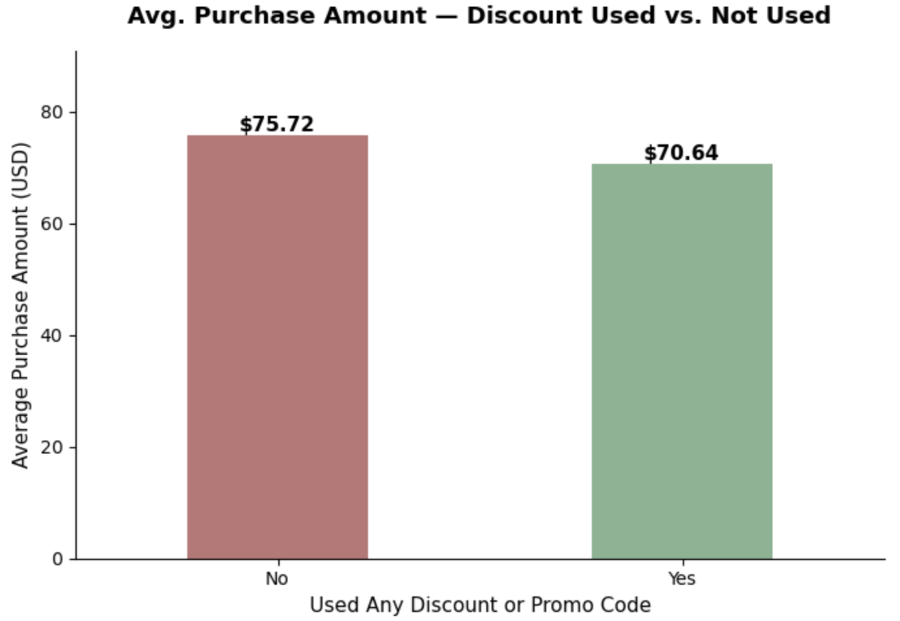
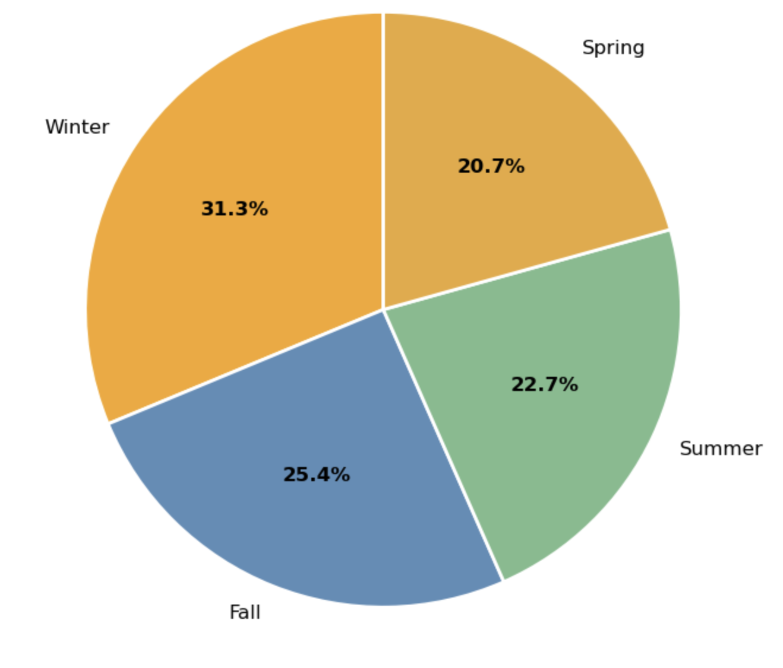
Seasonal trends & discounts
Discounts cut margin.
Not hesitation.
Transactions by Season
~Equal
KDE seasonal curves
46%
Spring + Fall share
⚠ Customers who used a discount shopped LESS on average — discounts are rewarding decisions already made, not creating new ones.

Slide 8
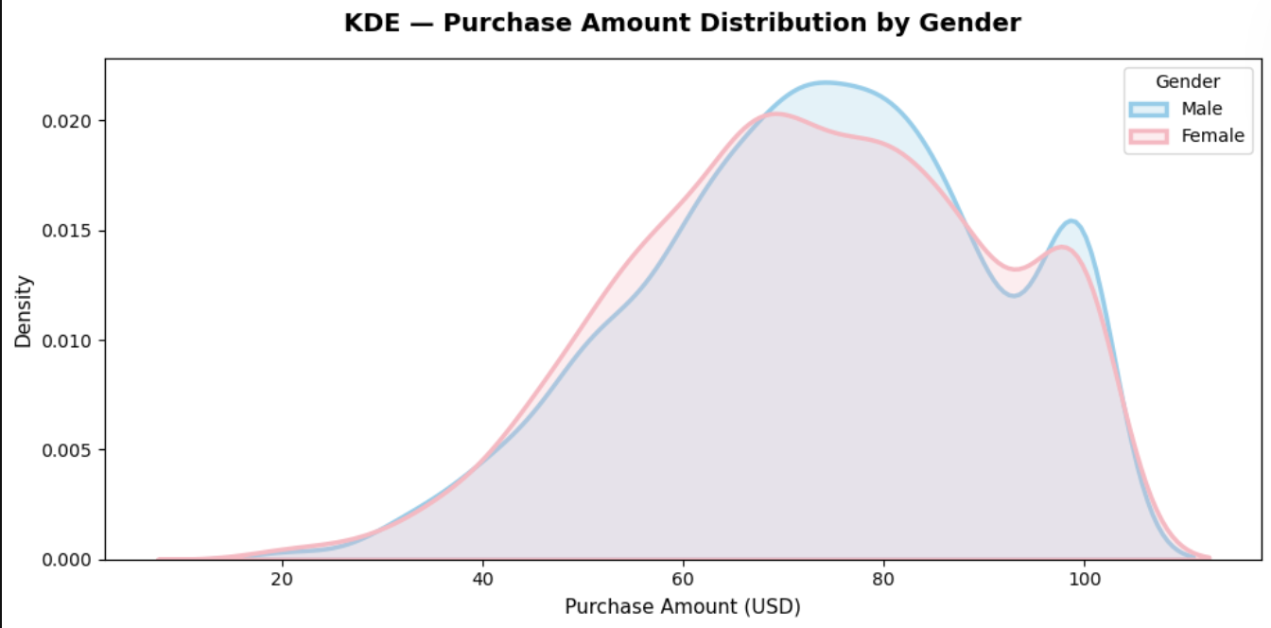
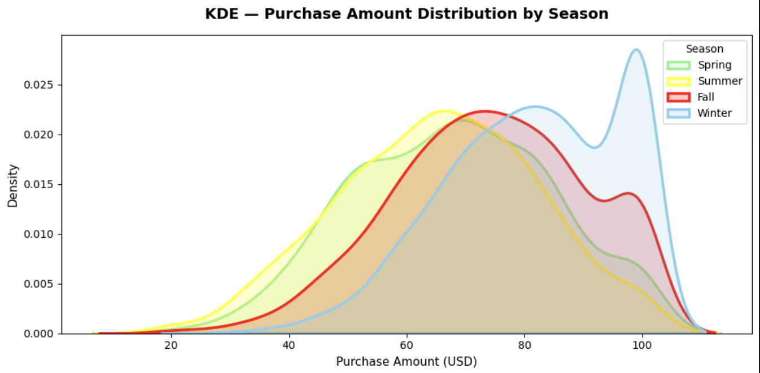
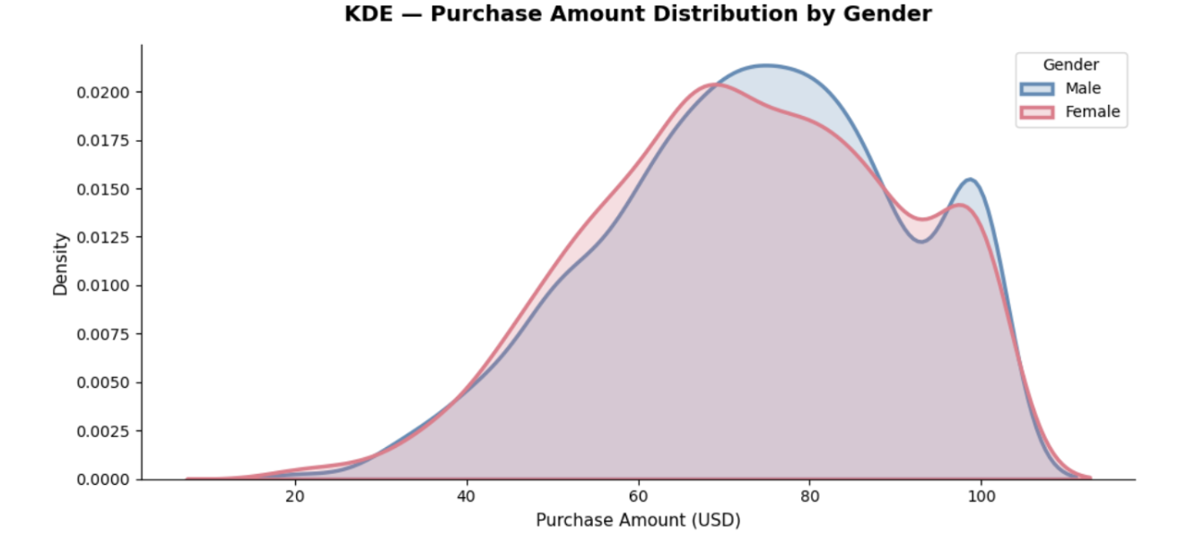
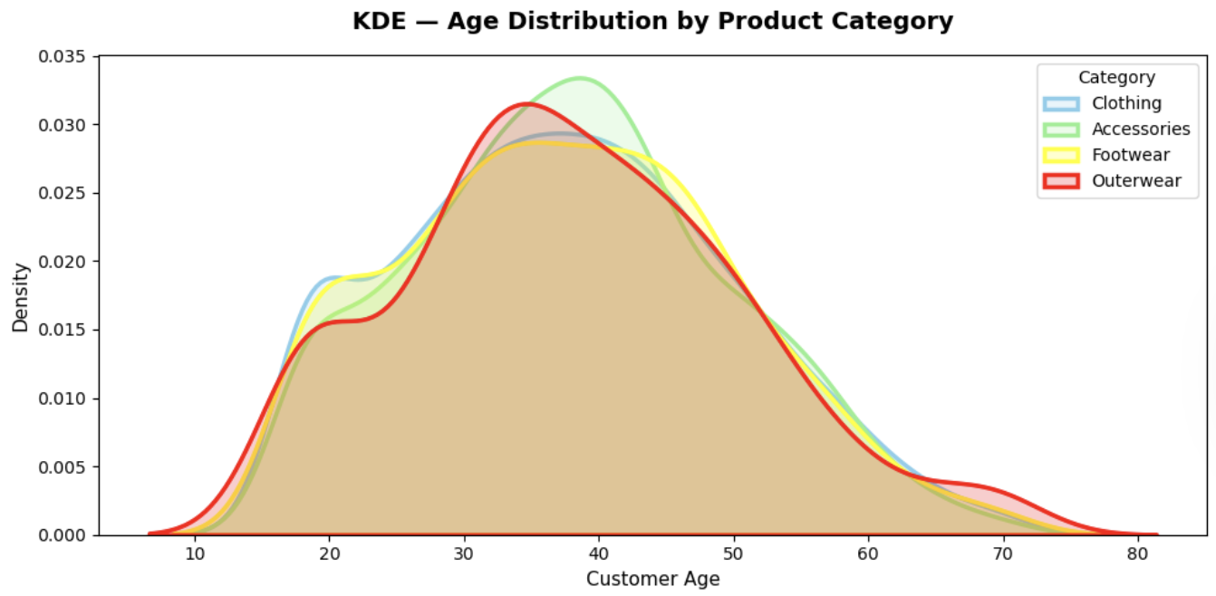
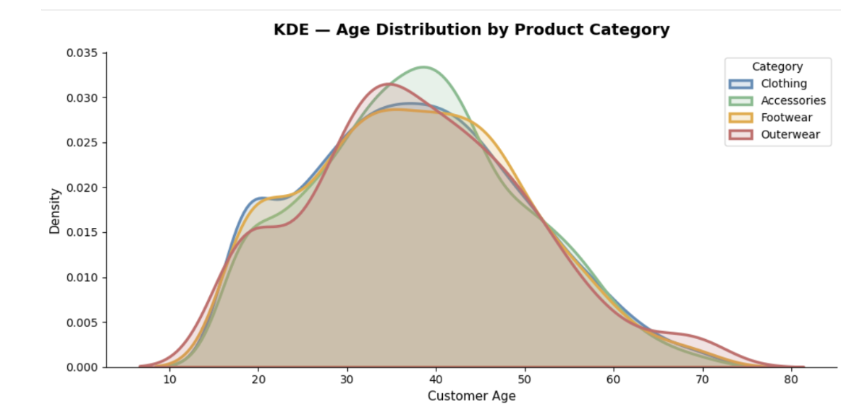
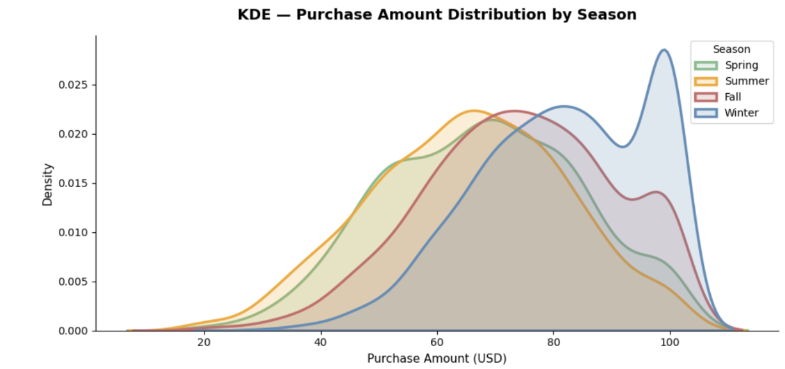
KDE Analysis
What the full distributions reveal
What is KDE? A histogram shows raw counts. KDE smooths those bars into a probability curve — showing the true shape of the data. When two groups' curves overlap perfectly, their behaviour is statistically identical — not just similar in average.
Fig 12 — Gender vs Spend
Fig 13 — Age by Category
Fig 14 — Season vs Spend
Male & Female spending curves overlap almost perfectly. Gender is NOT a spending predictor. The distributions aren't just similar in average — they are identical in shape across the entire range.
All four category curves spread evenly across ages 18–70. No category skews sharply young or old. Outerwear shows a very slight 35–50 lean — worth monitoring, but a subtle signal, not a rule.
Spring, Summer, Fall, Winter — all four seasonal spending curves sit on top of each other. Price range is genuinely season-neutral. No seasonal pricing adjustments are needed or justified.

Slide 9
Key insights
What the data actually says.
Clothing dominates
Demographics are irrelevant
43% of total revenue. Any disruption — stock-outs, quality issues, pricing changes — has outsized consequences for the whole business.
Age and gender show zero meaningful correlation with spend. A 65-year-old and an 18-year-old contribute identical value per transaction (~$73).
Discounts hurt margin
Seasonality is flat
Discount users spend LESS on average. Promos currently reward purchases that would have happened anyway — a textbook margin giveaway.
No season dominates. Spring and Fall carry a slight consistent edge — a natural campaign window, not a dramatic spike to plan inventory around.
Behaviour beats demographics
Purchase frequency, subscription status, and category affinity are far stronger predictors of customer lifetime value than age or gender will ever be.

Slide 10
Recommendations
Three things worth doing.
One thing worth stopping.
01
02
Protect Clothing
Redesign Discounts
Highest revenue, most consistent demand. Prioritise inventory depth, seasonal variants, and prominent digital placement. A stock-out in Clothing affects the entire business.
Replace flat-rate discounts with basket-size thresholds — e.g. 15% off orders above $90. Converts a margin cost into an actual growth lever that incentivises bigger spends.
03
04
Behavioural Segments
Stop Demographic Targeting
Build customer segments around purchase frequency, subscription status, and category affinity. These predict lifetime value far better than age or gender ever will.
Reallocate budget away from age/gender campaigns. The data is clear: spending does not vary by demographic. Redirect spend into retention and frequency programs.

Slide 11
Conclusion
Consistent customers.
Untapped potential.
The customer base is healthy — spending evenly across ages, genders, categories, and seasons. No golden demographic to chase, no single season to bet everything on.
KDE confirms these patterns aren’t flukes in the averages. The full distributions overlap. The consistency is real.
The edge lies in depth: higher purchase frequency, bigger baskets, stronger loyalty.
Future scope: ML clustering for behavioural personas; predictive modelling for churn risk and lifetime value.
Clothing — protect it
Discounts — redesign them
Demographics — stop targeting them
Behaviour — start targeting this
“The opportunity lies in converting consistency into depth — more frequent purchases, higher basket sizes, stronger retention.”
Team Nebula · Vansh Jain · Kapish Garg · Bhavya

